Slide 1
Scala
What is it all about and why should we use it

Slide 2
Topics Covered
What is Scala and Functional Programming?
Introduction to Scala
Scala vs. Python
Q/A and Scala Resources

Slide 3
A Brief Foray into Functional Programming (FP) part-I
Can we even define “Functional Programming”?
Better to talk about the tenants of FP
First-class / Higher-order functions
(Functional) Purity
Immutable Data / Immutability
Referential Transparency
Notes:
Defining FP:
Well, its not “Procedural Programming” (“C” - old school)
And its not “Object Oriented Programming”
So what is it then? (many definitions), so lets talk about the tenants of FP…

Slide 4
A Brief Foray into FP (part-II)
First-class Functions
Functions are types
Functions are values
Higher-order Functions
Takes one or more functions as arguments
And/or returns a function as a result
Notes:
Functions can accept functions as arguments and return functions as results
“Select(Func<…> selector)” or “Map” (as its known to the non-MS world) is an example of a Higher-order function
Functions can also be variables, and can be used everywhere a variable can be used.

Slide 5
A Brief Foray into FP (part-III)
Referential Transparency / Functional Purity
Example (C#): Func<int, int> Doubles = (x: int) => x * 2;
Some benefits:
Easy to test/debug
Memoization, compiler optimizations possible, simplicity
Not always possible
Notes:
A function is “Referentially Transparent” if for any given set of arguments (x₁, x₂, …, x_{n}), the function always returns the same result
Another definition: Functions do not mutate (change) any state
Writing to disk, updating a database table, or sending network packets is by the strict definition “mutating state”
Programs need to interact with the real world, so we cannot write strictly functional programs

Slide 6
A Brief Foray into FP (part-IV)
Immutability / Immutable Data
Cannot be changed later
“Value” vs. “Variable”
Example (F#) →
Benefits:
Inherently thread safe
Easy to debug/trace
Easy to reason about
type Tree<'LeafData,'INodeData> =
| LeafNode of 'LeafData
| InternalNode of 'INodeData * Tree<'LeafData,'INodeData> seq
Notes:
Once a value is defined, it can’t be changed
In some cases, a value can be defined, and then assigned later
Key point is “cannot be changed”

Slide 7
Why FP (with OOP)?
Functional Programming
Stress immutability – “Hopefully, there should never be surprises in code.”
Think – “transforms over simple data objects” vs. “complex data objects with associated functionality”
Pure functional code is easier to test (probably not controversial)
Some problems are just hard to solve in OOP (expression problem)
With OOP
While functional programming makes it easier to reason about how your program will function (correctness)
Object Oriented Programming makes it easier to sanely layout your functions and data objects (structure/format)

Slide 8

With Functional Programming…

Slide 9
What is a “Scala” Anyway?
SCAlable LAnguage -> Scala
Hybrid (“multi-paradigm” to be fancy) Object Oriented / Functional
JVM-based, compiled (to bytecode)
Full Java interoperability, statically typed (type safety!)
Approximately 11 years old
Programs are a series of expressions (not statements – more later)
Honestly…Scala – because we are not ready to write Haskell all day!

Slide 10
Popular Frameworks on Scala
Akka / Akka Streams
Play Framework
Spark
Kafka
Scalding
Kestrel
Summingbird/Algebird
ScalaZ (do not look at this unless you are a Scala/FP veteran – you have been warned!)
So many others - https://github.com/lauris/awesome-scala

Slide 11
Scala Features
Type Inference
Uniform Access Principal
Closures
Currying
Higher Order Functions
Pattern Matching
Actors
Generics (covariance)
Higher Order Kinds
Tail-call optimization
DSLs
Native XML support
Implicit conversions
Expression evaluation
Annotations
Combinator parsing
Traits
Duck typing
Lazy evaluation
And more…

Slide 12
A (very) Brief Introduction to Scala
Collection Types:
Immutable and Mutable
 | Scala | Python
Array | Array(1, 2, 3, 4) | {1, 2, 3, 4}
Tuple | (1, 2, 3, 4) | (1, 2, 3, 4)
List | List(1, 2, 3, 4) | (1, 2, 3, 4)
Map (dictionary) | Map(“a” -> 1, “b” -> 2) | {“a”:1, “b”: 2}
Set | Set(1, 2, 3, 4) | set(1, 2, 3, 4)
 | …Many others

Slide 13
(Obligatory) “Hello World” in Scala
object Program extends App {
println "Hello World!" // println(“Hello World!”)
}

Slide 14
Pattern Matching (level up)
def factorial(n: BigInt): BigInt = n match {
case 0 => 1
case n => n * fact(n - 1)
}
def length[A](list : List[A]) : Int = list match {
case _ :: tail => 1 + length(tail)
case Nil => 0
}
def parseArgument(arg : String, value: Any) = (arg, value) match {
case ("-l", lang) => setLanguageTo(lang)
case ("-o" | "--optim", n : Int) if ((0 < n) && (n <= 5)) => setOptimizationLevelTo(n)
case ("-o" | "--optim", badLevel) => badOptimizationLevel(badLevel)
case ("-h" | "--help", null) => displayHelp()
case bad => badArgument(bad)
}

Slide 15
Rich Type System
Functions, Partial Functions, and Functional Types
Function:
Partial Function:
Functional Type:
Generic Types (with variance)
Foo[T], Bar[-U, +T]
Higher Kinded Types
Functor:
Structural Types
Shape-like:
val sum : (Int, Int) => Int = (x, y) => x + y
val bigBang : PartialFunction[String, String] = { case "Sheldon" => "Bazinga!" }
class ExprParser extends String => String { def apply(str: String) = ??? }
trait Functor[F[_]] {
def map[A, B] (fa: F[A]) (xform: A => B) : F[B]
}
def setElementText(element: {def setText(text: String)}, text: String) = {
//...
}

Slide 16
Easy Records (data objects)
Python “Person” Record
Scala “Person” Record
class Person(object):
def __init__(self, name, age):
self.name = name
self.age = age
def __str__(self):
return str(“Person(%s)” % self.__dict__)
def __eq__(self, other):
return self.__dict__ == other.__dict__
case class Person(var name: String, var age: Int)
Free accessors (and mutators if you must)
Free equals() and hashCode()
Free toString()
Free copy()
Free apply(…) and unapply()
Unapply used for pattern matching

Slide 17
Stupid Powerful Collections Ops:
Functions over Collections* | Type Signature
map | (Seq[A], f: A->B) -> Seq[B]
flatMap (!!) | (Seq[A], f: A -> Seq[B]) -> Seq[B]
filter (and filterNot) | (Seq[A], f: A -> Bool) -> Seq[A]
zip (and zipWithIndex) | (Seq[A], Seq[B]) -> Seq[A * B]
find | (Seq[A], f: A -> Bool) -> Option[A]
drop (and dropWhile) | (Seq[A], n: Int) -> Seq[A]
take (and takeWhile) | (Seq[A], n: Int) -> Seq[B]
fold (and foldLeft / foldRight) | (Seq[A], init: B, f: (B, A) -> B) : B
collect | (Seq[A], f: PF[A, B]) -> Seq[B]
reduce | (Seq[A], f: (A, A) -> A) : A
* Works on every collection, even the ones you create!

Slide 18
Powerful DSL capabilities
class HelloWorldSpec extends Specification {
"This is a specification for the 'Hello world' string".txt
val actual = "Hello world"
"The 'Hello world' string should" should {
"contain 11 characters" in {
actual must haveSize(11)
}
"start with 'Hello'" in {
actual must startWith("Hello")
}
"end with 'world'" in {
actual must endWith("world")
}
"start with a capital word and end with a lowercase word" in {
val words = actual split " "
words(0) must equal capitalize(word(0))
words(1) must equal words(0).toLowerCase
}
}
}

Slide 19
class Phrase(value: String) {
// Method
def wordCount : Map[String, Int] =
words.foldLeft(Map.empty[String, Int]) {
case (acc, word) => acc get word match {
case Some(cnt) => acc + (word -> cnt + 1)
case None => acc + (word -> 1)
}
}
// Property (lazy evaluated – only evaluated once)
lazy val words : Seq[String] = {
value toLowerCase split "[^a-zA-Z0-9']+"
}
}

Slide 20
object LongestIncreasingSubsequence {
@tailrec
private def iterateAndDropHead(folded: Seq[Seq[Int]], remaining: Seq[Int]): Seq[Seq[Int]] = {
remaining match {
case head :: Nil => folded
case head :: tail => iterateAndDropHead(folded :+ tail, tail)
}
}
private def findIncreasingSubsequence(sequence: Seq[Int]) : Seq[Int] = {
sequence.foldLeft(Seq(sequence.head)) {
(acc, elem) => if (acc.last < elem) acc :+ elem else acc
}
}
def apply(sequence: Seq[Int]) : Seq[Int] = {
iterateAndDropHead(Seq(sequence), sequence)
.map(findIncreasingSubsequence)
.sortBy(_.length)(Ordering[Int].reverse)
.head
}
}

Slide 21
Batteries Included
Bootstrapping Libraries (libraries I’ve used):
Sbt – Declarative project configuration and build tool (write configuration in Scala, with full IDE support)
Akka – Actors, understandable concurrency, HTTP microservices, reactive streams, easy clusters/clustering
Config – Powerful yet simple configuration library
Specs2 – Descriptive, easy to write unit tests
SlickDB – Strongly typed ORM with code generation and raw SQL macros
Play / Scalatra – Full purpose web server with all the bells and whistles
Every war-ready / battle hardened Java library – Directly consume or easily create idiomatic Scala wrappers

Slide 22
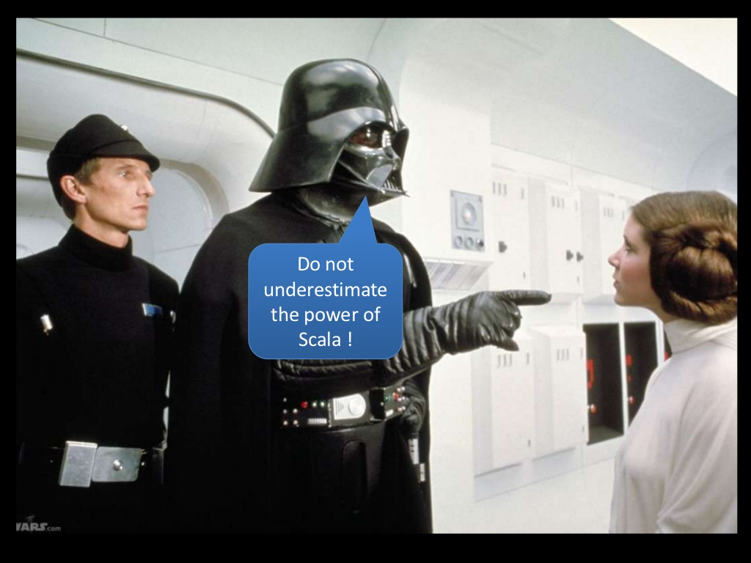

Slide 23
Scala vs. Python (Python)
Expressive
Simple to learn
Plethora of libraries
No curly braces
Low/no boilerplate
Fast development time
About 25% less lines of code than Scala
Lacks Type Safety
Slower debugging time
Less useful/intelligent IDEs
Global Interpreter Lock (no true multi-threading)
Lackluster performance
“Easier to…”
Write code without thinking
Shoot yourself in the foot

Slide 24
Scala vs. Python (Scala)
Full Type Safety
Helpful/intelligent IDEs
Plethora of libraries
Type inference
Low boilerplate
Fast debugging time
Very flexible / powerful
Easy concurrency (multiple models)
Performance (can match Java)
A compiler!!!
Harder to learn, difficult to master
Dense code/more complex syntax
“Any sufficiently complex abstraction is indistinguishable from magic”
Slower development time
More lines-of-code (LOC)
Boilerplate does still exist
“Harder to…”
Get something running
But also – harder to make mistakes

Slide 25
Performance
Test Program |  | C++ Time | Java Time | Scala Time | % Slower | |%Slower| | Python Time | % Slower | |%Slower|
 | binary-trees | 0.27 | 0.71 | 0.94 | 32% | 37% | 5.64 | 500% | 1254%*
 | chameneos-redux | 0.38 | 1.05 | 1.85 | 76% |  | 28.35 | 1432%
 | fannkuch-redux | 1.89 | 5.19 | 7.21 | 39% |  | 156.13 | 2065%
 | fasta | 0.66 | 0.96 | 1.54 | 60% |  | 15.91 | 933%
 | k-nucleotide | 1.35 | 4.19 | 5.55 | 32% |  | 7.44 | 34%
 | mandelbrot | 0.39 | 0.57 | 0.89 | 56% |  | 16.61 | 1766%
 | n-body | 1.94 | 2.44 | 2.79 | 14% |  | 84.81 | 2940%
 | regex-dna | 0.65 | 1.71 | 1.48 | -13% |  | 2.39 | 61%
 | reverse-complement | 0.55 | 0.4 | 0.55 | 38% |  | 0.81 | 47%
 | spectral-norm | 0.66 | 1.43 | 1.87 | 31% |  | 53.56 | 2764%
*std-dev: 1,111.2%, median: 1,183%

Slide 26
Closest Sequence
def closestSequence2(a, b): K = len(b) - len(a) + 1 c = lambda i, j: abs(a[i] - b[j]) L = [0 for _ in range(K)] # let i = -1 for i in range(len(a)): for offset in range(K): j = i + offset skip = L[offset - 1] if offset > 0 else 2**100 take = L[offset] + c(i, j) L[offset] = min(skip, take) return L[-1] | val m = mutable.HashMap[(List[Int], List[Int]), Int]() def closestSequence2(a: Array[Int], b: Array[Int]) = d(a.toList, b.toList) def d(a: List[Int], b: List[Int]): Int = { m.getOrElseUpdate( (a,b), ( if (a.isEmpty || b.isEmpty) 0 else (a(0) - b(0)).abs + d(a.tail, b.tail)) min ( if (a.size < b.size) d(a, b.tail) else 99999999)) }
Notes:
Closest Sequence:
“The difference between two sequences of the same length a₁, a₂, a₃,..., a_{n} and b₁, b₂, b₃,..., b_{n} can be defined as the sum of absolute differences between their respective elements:
diff(a, b) = |a₁ - b₁| + |a₂ - b₂| + ... + |a_{n} - b_{n}|.
For the given sequences a and b (not necessarily having the same lengths) find a subsequence b' of b such that diff(a, b') is minimal. Return this difference.”

Slide 27
Dijkstra’s Algorithm (Python vs. Scala)
Demo!

Slide 28
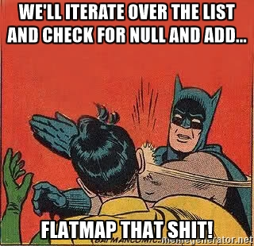

When in doubt (or in danger)…

Slide 29
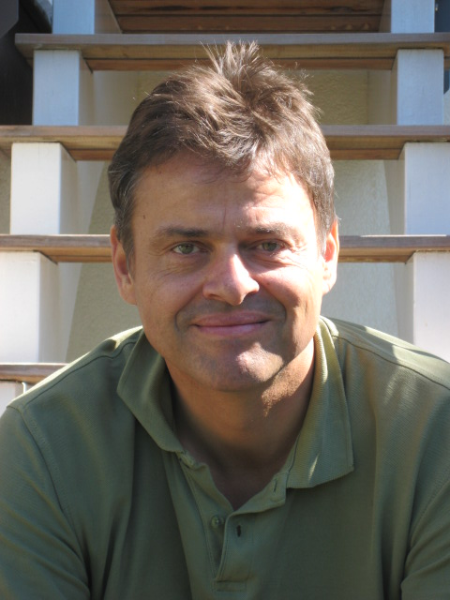
Thank You for your time!
Questions?

Slide 30
Learning Scala – Resources
Getting Started (REPL): “brew install scala” -> “scala”
https://bugra.github.io/work/notes/2014-10-18/scala-basics-for-python-developers/
https://rosettacode.org/wiki/Category:Scala
https://www.cis.upenn.edu/~matuszek/Concise%20Guides/Concise%20Scala.html
https://twitter.github.io/scala_school/
http://www.scala-lang.org/docu/files/ScalaTutorial.pdf (Java/C# experience helpful here)
Time to level up? http://nerd.kelseyinnis.com/blog/2013/01/07/resources-for-getting-started-with-functional-programming-and-scala/

